Slide 1
ELIMINATION
REACTIONS OF ALKYL HALIDES
!

Slide 2
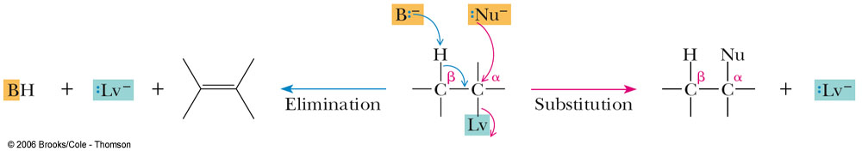
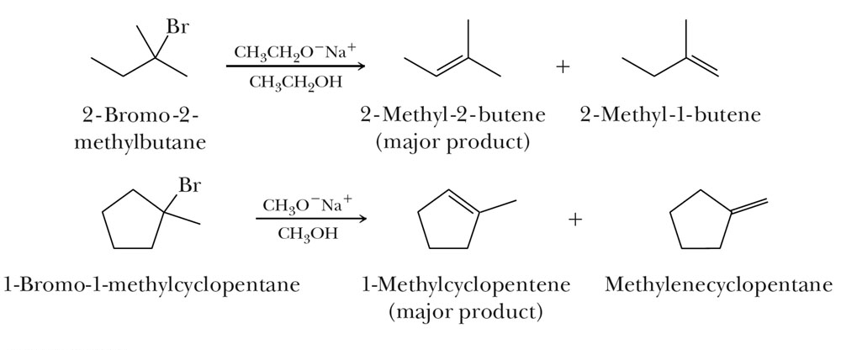
β elimination: competes with nucleophilic substitution.
The competition:
S_{N}1 and/orS_{N}2
Zaitsev Rule, prefer to form the more substituted alkene (more stable).

Slide 3
There are two idealized mechanisms for β-elimination reactions
E1 mechanism: at one extreme, breaking of the R-Lv bond to give a carbocation is complete before reaction with base to break the C-H bond
  only R-Lv is involved in the rate-determining step (as in S_{N}1)
E2 mechanism: at the other extreme, breaking of the R-Lv and C-H bonds is concerted (same time)
  both R-Lv and base are involved in the rate-determining step (as in S_{N}2)

Slide 4
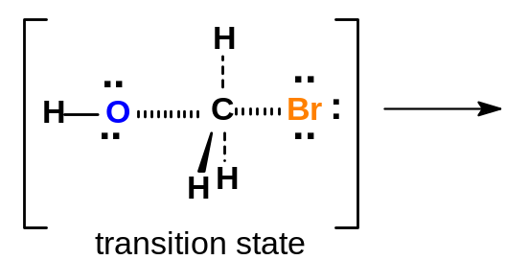
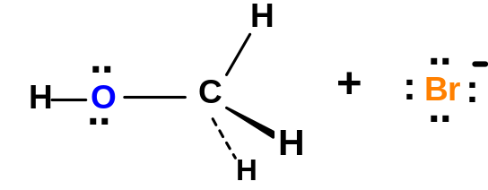


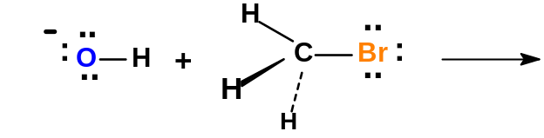
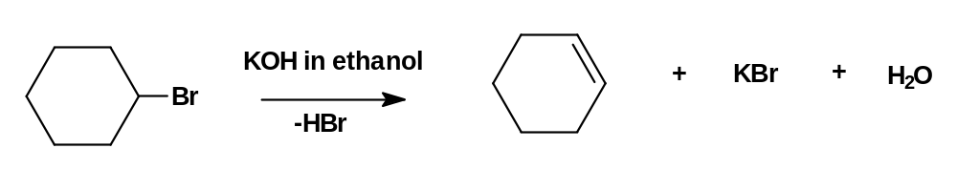
Elimination Reactions, E1 and E2:
We have seen that alkyl halides may react with basic nucleophiles such as NaOH via substitution reactions.
Also recall our study of the preparation of alkenes. When a 2° or 3° alkyl halide is treated with a strong base such as NaOH, dehydrohalogenation occurs producing an alkene – an elimination (E2) reaction.
bromocyclohexane + KOH → cyclohexene (80 % yield)
Substitution and elimination reactions are often in competition. We shall consider the determining factors after studying the mechanisms of elimination.

Slide 5
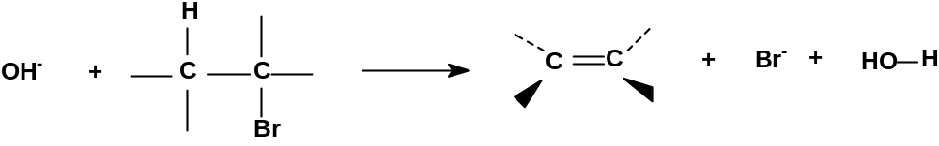



E2 Reaction Mechanism
There are 2 kinds of elimination reactions, E1 and E2.
E2 = Elimination, Bimolecular (2nd order). Rate = k [RX] [Nu:⁻]
E2 reactions occur when a 2° or 3° alkyl halide is treated with a strong base such as OH⁻, OR⁻, NH₂⁻, H⁻, etc.
The Nu:⁻ removes an H⁺ from a β-carbon & the halogen leaves forming an alkene.
All strong bases, like OH⁻, are good nucleophiles. In 2° and 3° alkyl halides the α-carbon in the alkyl halide is hindered. In such cases, a strong base will ‘abstract’ (remove) a hydrogen ion (H+) from a β-carbon, before it hits the α-carbon. Thus strong bases cause elimination (E2) in 2° and 3° alkyl halides and cause substitution (S_{N}2) in unhindered methyl° and 1° alkyl halides.

Slide 6
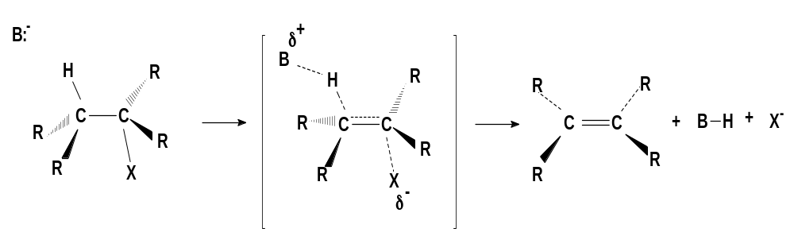
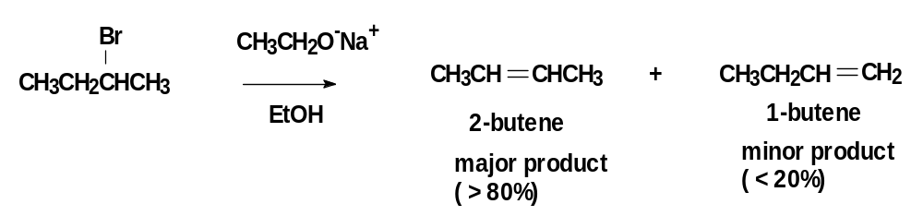
E2 Reaction Mechanism
In E2 reactions, the Base to H σ bond formation, the C to H σ bond breaking, the C to C π bond formation, and the C to Br σ bond breaking all occur simultaneously. No carbocation intermediate forms.
Reactions in which several steps occur simultaneously are called ‘concerted’ reactions.
Zaitsev’s Rule:
Recall that in elimination of HX from alkenes, the more highly substituted (more stable) alkene product predominates.

Slide 7
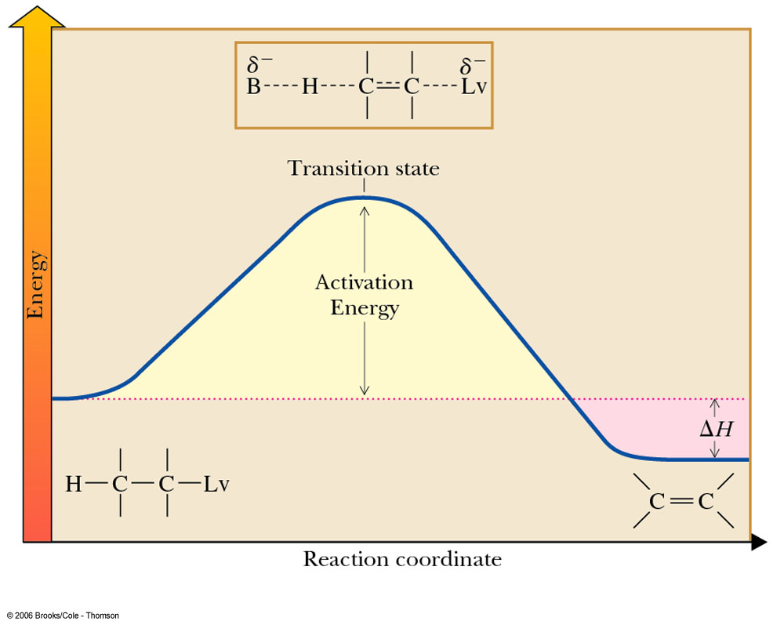
E2

Slide 8
E2 Reactions are ‘antiperiplanar’
E2 reactions, do not always follow Zaitsev’s rule.
E2 eliminations occur with anti-periplanar geometry, i.e., periplanar means that all 4 reacting atoms - H, C, C, & X - all lie in the same plane. Anti means that H and X (the eliminated atoms) are on opposite sides of the molecules.
Look at the mechanism again and note the opposite side & same plane orientation of the mechanism:

Slide 9

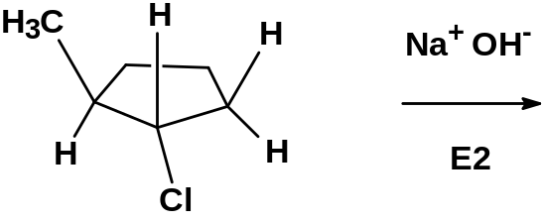
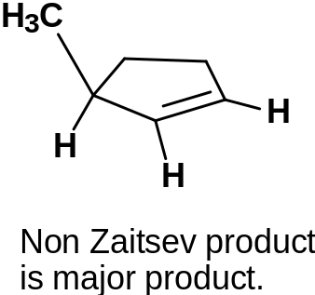
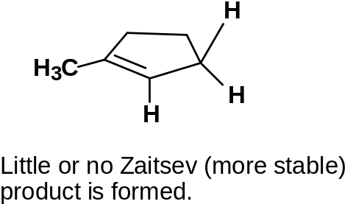

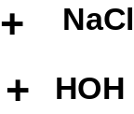



Antiperiplanar E2 Reactions in Cyclic Alkyl Halides
When E2 reactions occur in open chain alkyl halides, the Zaitsev product is usually the major product. Single bonds can rotate to the proper alignment to allow the antiperiplanar elimination.
In cyclic structures, however, single bonds cannot rotate. We need to be mindful of the stereochemistry in cyclic alkyl halides undergoing E2 reactions.
See the following example.
Trans –1-chloro-2-methylcyclopentane undergoes E2 elimination with NaOH. Draw and name the major product.

Slide 10
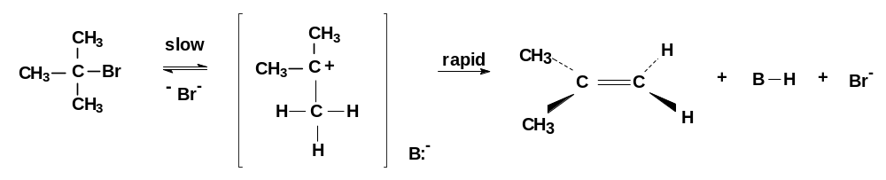
E1 Reactions
Just as S_{N}2 reactions are analogous to E₂ reactions, so S_{N}1 reactions have an analog, E1 reaction.
E1 = Elimination, unimolecular (1st order); Rate = k × [RX]
E1 eliminations, like S_{N}1 substitutions, begin with unimolecular dissociation, but the dissociation is followed by loss of a proton from the β-carbon (attached to the C⁺) rather than by substitution.
E1 & S_{N}1 normally occur in competition, whenever an alkyl halide is treated in a protic solvent with a nonbasic, poor nucleophile.
Note: The best E1 substrates are also the best S_{N}1 substrates, and mixtures of products are usually obtained.

Slide 11
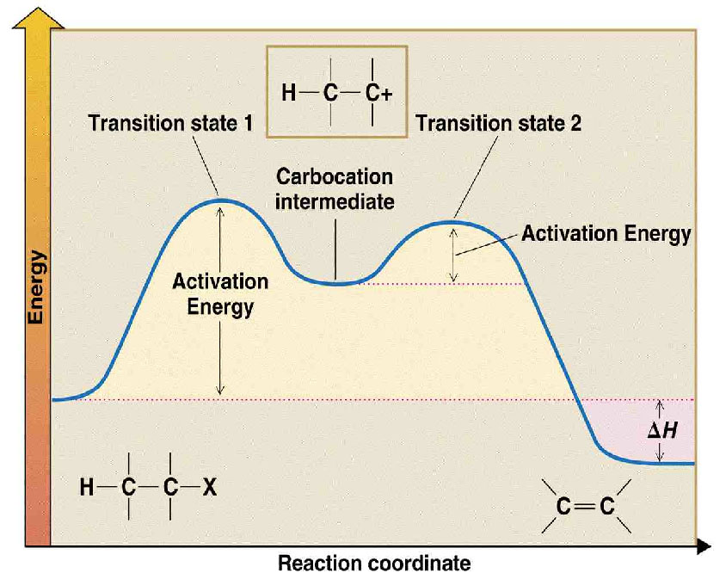
Energy Profile for E1 mechanism, carbocations.
Rate Determining Step; formation of the carbocation.
Reaction can occur in either direction…..
Alkyl Halide → (E1) Alkene + HX
Alkyl Halide ← (Addition) Alkene + HX

Slide 12
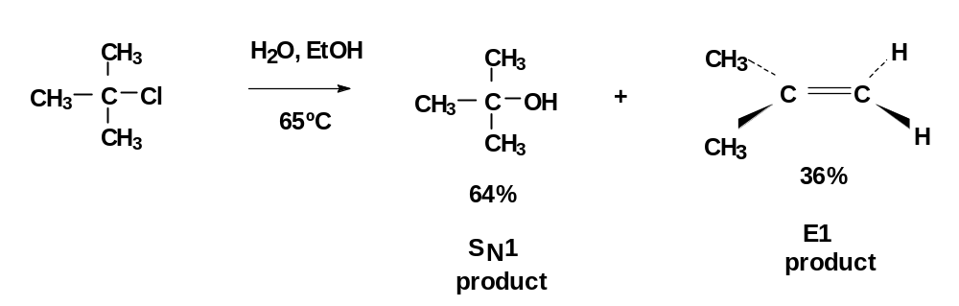
E1 Reactions
As with E2 reactions, E1 reactions also produce the more highly substituted alkene (Zaitsev’s rule). However, unlike E2 reactions where no C⁺ is produced, C⁺ rearrangements can occur in E1 reactions.
e.g., t-butyl chloride + H₂O (in EtOH) at 65 °C → t-butanol + 2-methylpropene
In most unimolecular reactions, S_{N}1 is favored over E1, especially at low temperature. Such reactions with mixed products are not often used in synthetic chemistry.
If the E1 product is desired, it is better to use a strong base and force the E2 reaction.
Note that increasing the strength of the nucleophile favors S_{N}1 over E1. Can you postulate an explanation?

Slide 13
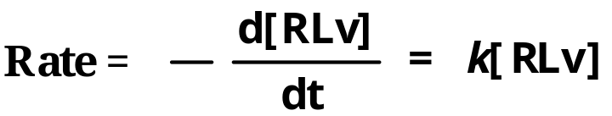
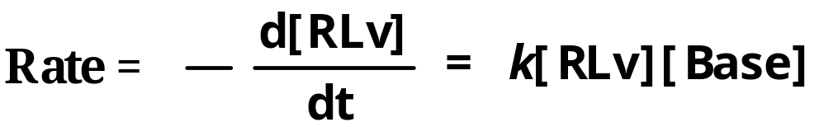
Kinetics of E1 and E2
E1 mechanism
  reaction occurs in two steps
  the rate-determining step is carbocation formation involving only RLv
  the reaction is 1st order in RLv and zero order in base
E2 mechanism
  reaction occurs in one step involving both RLv and the base.
  reaction is 2nd order; first order in RLv and 1st order in base

Slide 14
Regioselectivity of E1/E2
E1: major product is the more stable alkene (more substituted, more resonance)
E2: with strong base, the major product is the more stable (more substituted, more resonance) alkene
Special notes about sterically hindered bases such as tert-butoxide, (CH₃)₃CO ⁻.
E2 – anti-Zaitsev: with a strong, sterically hindered base the major product is often the less stable (less substituted) alkene. Reason: hydrogens on less substituted carbons are more accessible.
Also
E2 vs S_{N}2: In competition of S_{N}2 vs E2: steric bulk in either the alkyl halide or the base/nucleophile prevents the S_{N}2 reaction and favors the E2.

Slide 15
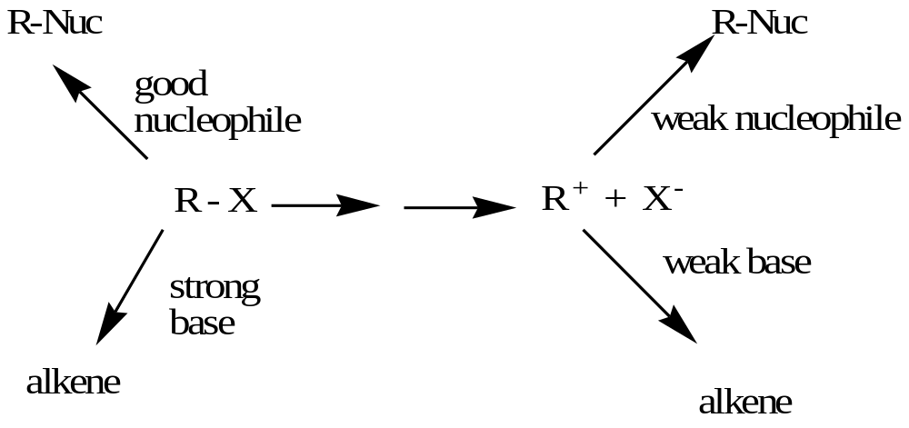
1º good nucleophiles, aprotic solvents
2º good nucleophiles but also poor bases, aprotic solvents
3⁰
1º
2º lower hinderance, better nucleophile than base
3º lower hinderance, better nucleophile than base
S_{N}2
S_{N}1
ionization
Rearrange ?
1º,
2º, 3º polar solvents, weak nucleophiles, weak bases
E2
1º strong, bulky bases
2º strong bases
3º strong bases
E1
1º
2º heat, more hindered
3º heat, more hindered

Slide 16
Predicting Reaction Mechanisms
Non basic, good nucleophiles, like Br⁻ and I⁻ will cause substitution not elimination. In 3° substrates, only S_{N}1 is possible. In Me° and 1° substrates, S_{N}2 is faster. For 2° substrates, the mechanism of substitution depends upon the solvent.
Strong bases, like OH⁻ and OR⁻, are also good nucleophiles. Substitution and elimination compete. In 3° and 2° alkyl halides, E2 is faster. In 1° and Me° alkyl halides, S_{N}2 occurs.
Weakly basic, weak nucleophiles, like H₂O, EtOH, CH₃COOH, etc., cannot react unless a C+ forms. This only occurs with 2° or 3° substrates. Once the C+ forms, both S_{N}1 and E1 occur in competition. The substitution product is usually predominant.
High temperatures increase the yield of elimination product over substitution product. (ΔG = ΔH –TΔS) Elimination produces more products than substitution, hence creates greater entropy (disorder).
Polar solvents, both protic and aprotic, like H₂O and CH₃CN, respectively, favor unimolecular reactions (S_{N}1 and E1) by stabilizing the C+ intermediate. Polar aprotic solvents enhance bimolecular reactions (S_{N}2 and E2) by activating the nucleophile.

Slide 17
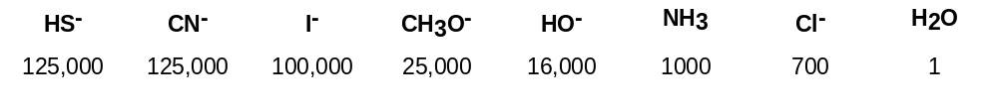
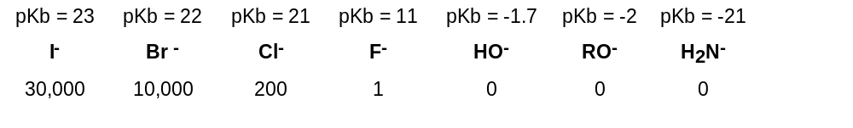
Summary of S_{N} /Elimination Reactions
Reactivity of Nucleophiles:
Note that poor nucleophiles that are also weak bases (H₂O, ROH, CH₃COOH, etc.) do not undergo any reaction unless a C⁺ is formed first. If a C⁺ can form (as with a 2º, 3º, any benzylic, or any allylic halides), then E1 and S_{N}1 generally occur together.
Leaving Group Activity:

